Slide 1
San Francisco
A tourist’s guide to many things!
By Trip Beernick, Lauren Calso, David Colonia, David Cruz, Phil Sohn

Slide 2
Our project includes:
Maps
Data
Markers
Leaflet
Mapbox
MySQL
HTML, CSS, JS

Slide 3



Our Lifelines
Leaflet GitHub Flask

Slide 4
Our Story
For project one...
For project two...

Slide 5
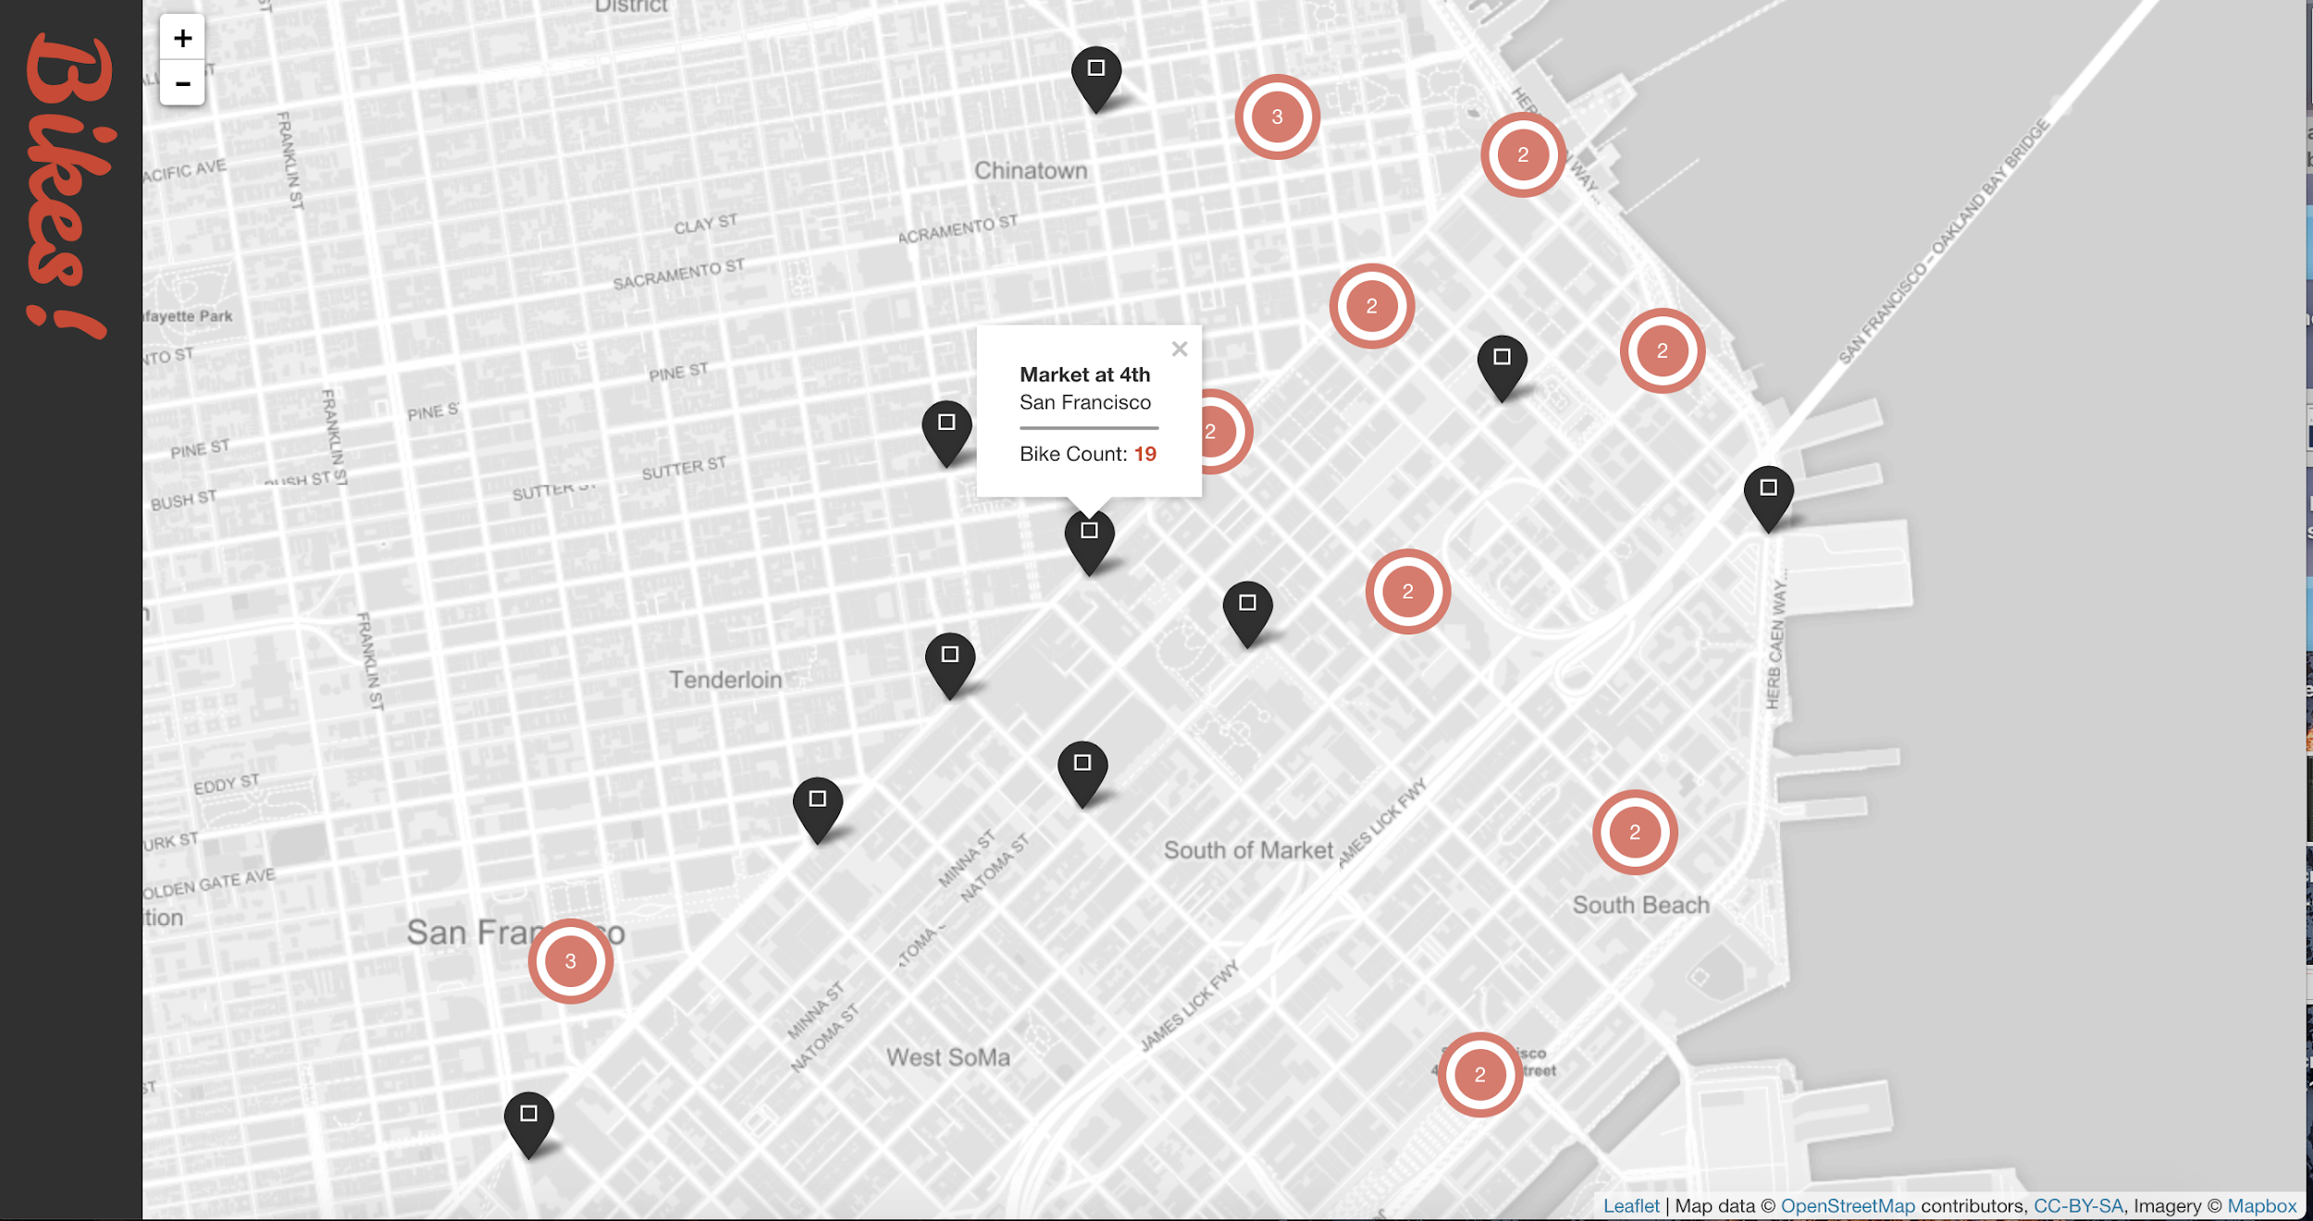

Slide 6
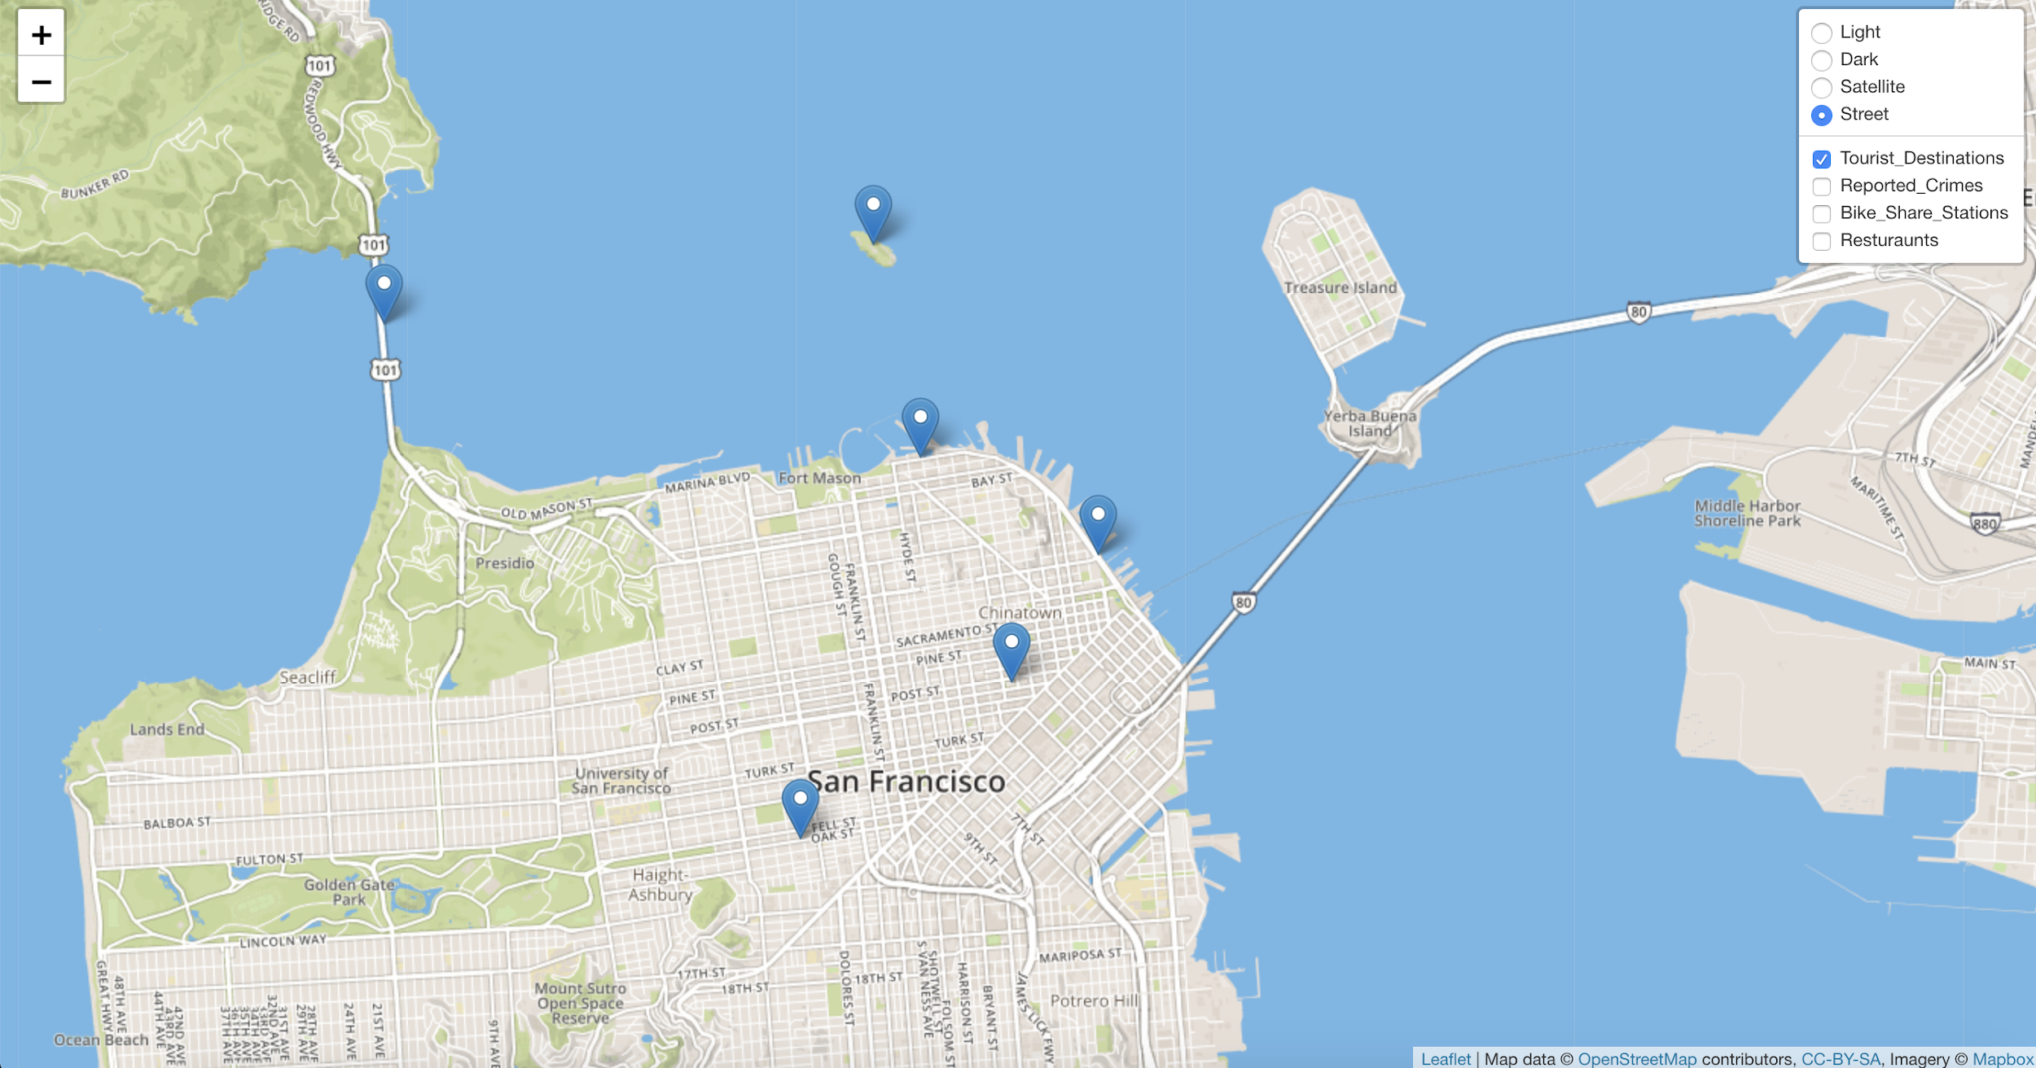
Tourist Destinations

Slide 7
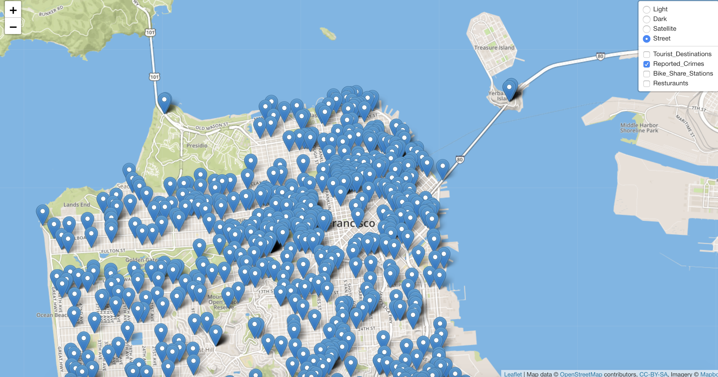
Reported Crimes

Slide 8
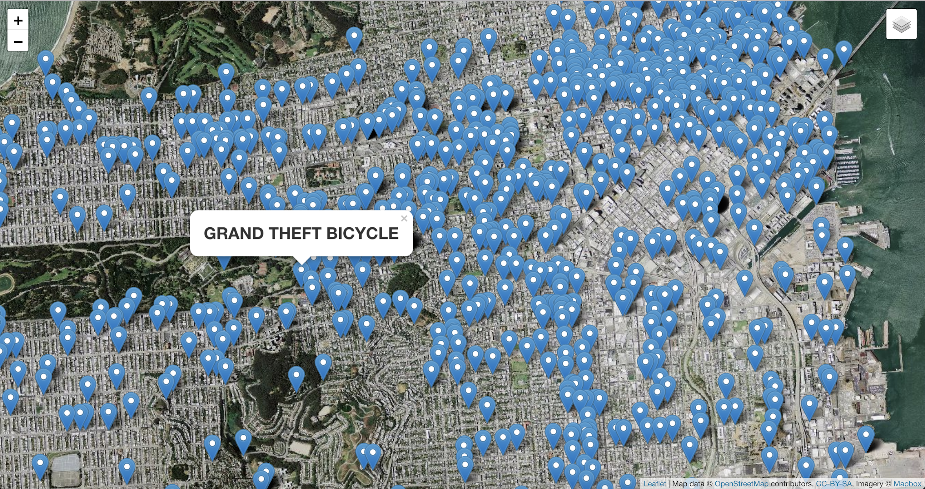

Slide 9
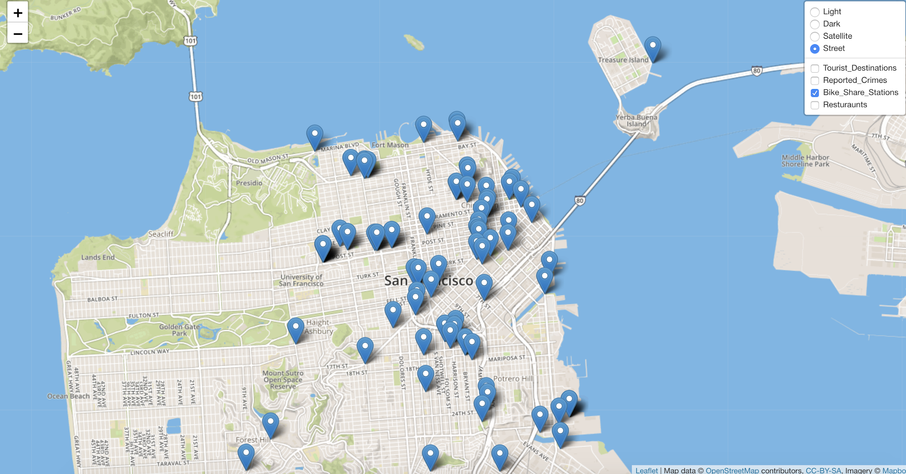
Bike Share Stations

Slide 10
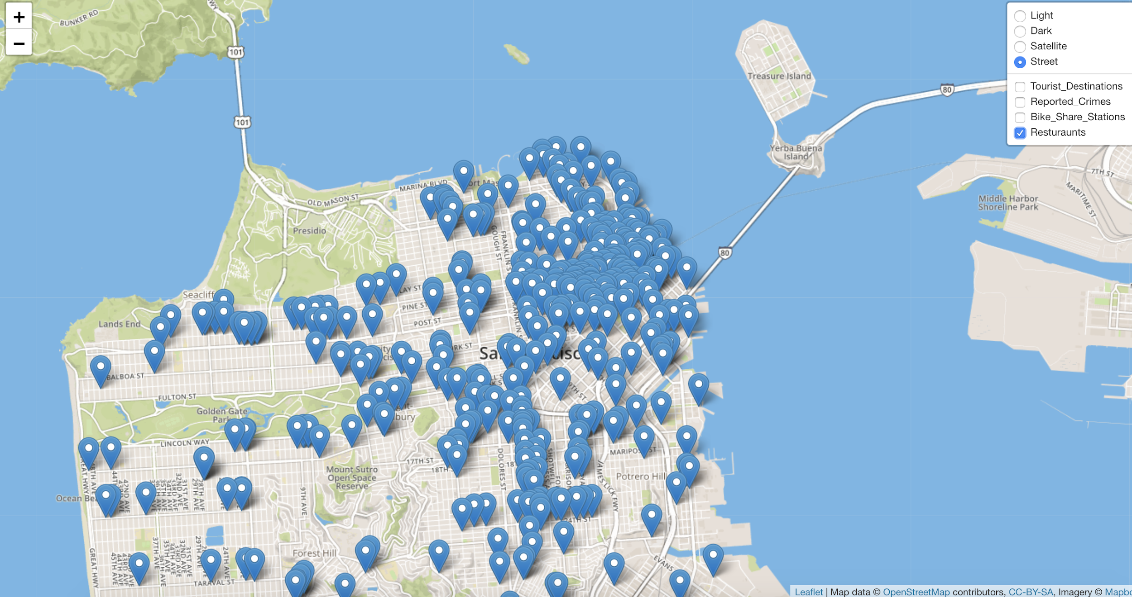
Restaurants

Slide 11
Results
Marina = low crime rate, several bike share locations and restaurants
Tenderloin = *danger danger!*

Slide 12
THANK YOU :)

